Slide 1
Generalization, Specialization & Aggregation

Slide 2
Generalization
Generalization proceeds from the recognition that a number of entity sets share some common features .
It is a bottom-up approach in which two lower level entities combine to form higher entity .
The higher level entity can also combine with other lower level entity to make further higher level entity .

Slide 3
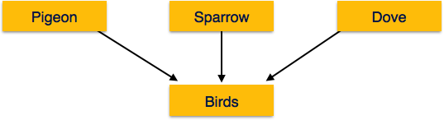
Example
For example, pigeon, house sparrow, crow and dove can all be generalized as Birds.

Slide 4
Specializations
It is a top-down approach in which one higher level entity can be broken down into lower level entity.
Specialization can be repeatedly applied to a design schema .
A group of entities is divided into sub-groups based on their characteristics .

Slide 5
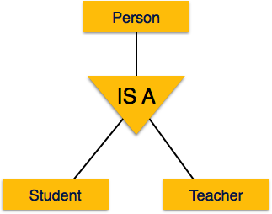
Example
A school database, persons can be specialized as teacher, student, or a staff, based on what role they play in school as entities.

Slide 6
Difference between Generalization & Specializations
It proceeds in a bottom-up manner.
It proceeds in a top-down manner.
The higher level entity must have lower level entities.
The higher level entity may not have lower level entities.
Generalization entities on group of entities.
Specialization is applied on a single entity.
It reduces the size of a schema.
Specialization increases the size of a schema.

Slide 7
Aggregations
Aggregations is an abstraction through which relationship are treated as high level entities.
An entity set is treated in the same manner as is any other entity set.

Slide 8
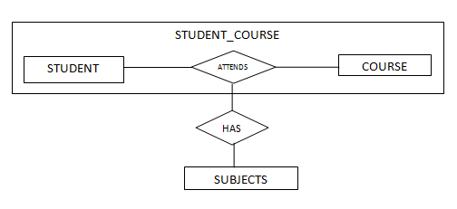
Example

Slide 9
What is a Key ?
A KEY is a value used to identify a record in a table uniquely.
A KEY could be a single column or combination of multiple columns .

Slide 10
Database Key
Database keys are defined in a table to access the stored data quickly and smoothly.

Slide 11
Importance of Database Key
The key ensure each record within a table can be uniquely identified by one or a combination of fields within the table.
It can be help identify the relationship between tables.

Slide 12
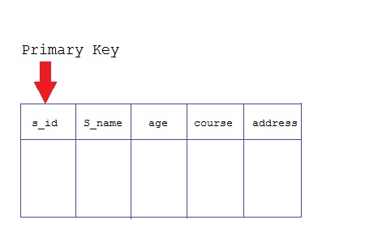
Type of Database Key
There are five types of database key as:
Primary Key : - Primary key is a key that is most appropriate to become main key of the table. It is a key that uniquely identify each record in a table .

Slide 13
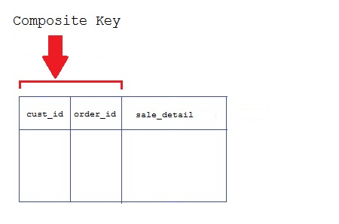
Continue….
Composite Key :- It is a Key that consist of two or more attributes that uniquely identify an entity is called Composite key.

Slide 14
Continue……
Foreign Key:- Foreign key are keys which is used to define relationship between two tables.
When we want to implement relationship between two tables then we use concept of foreign key.
Example:- person(pid,fname,lastname,age)
order(oid,onumber,pid)
pid is a Foreign Key.

Slide 15
Continue……
Candidate Key:- It is a minimal set of fields which can uniquely identify each record in a table.
It is an attribute or a set of attributes that can act as a Primary Key for a table to uniquely identify each record in that table.
Example, student_id and phone both are candidate keys for table Student.

Slide 16
Alternative Key/Unique Key
Out of all candidate keys, only one gets selected as primary key, remaining keys are known as alternate or secondary keys.
Example, Srudent(roll,regno,name,address)
Roll is a primary key and regno is alternative key.

Slide 17
Super Key
A super key is either a single or a combination of attributes that can be used to uniquely identify a database record.
A table might have many combinations that create super keys.
Example, Employee (Employee ID, Full Name, SSN, Dept ID)
Employee ID + Full Name is a Super Key.

Slide 18


